Slide 1
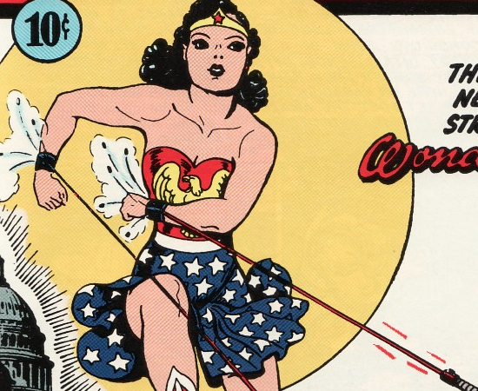
Wonder Woman

Slide 2
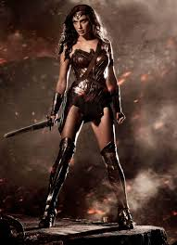

Slide 3
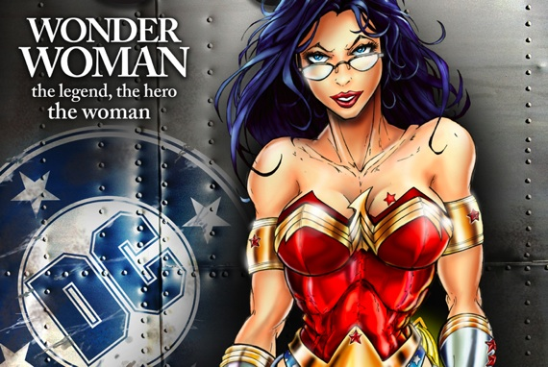
Gail Simone’s

Slide 4
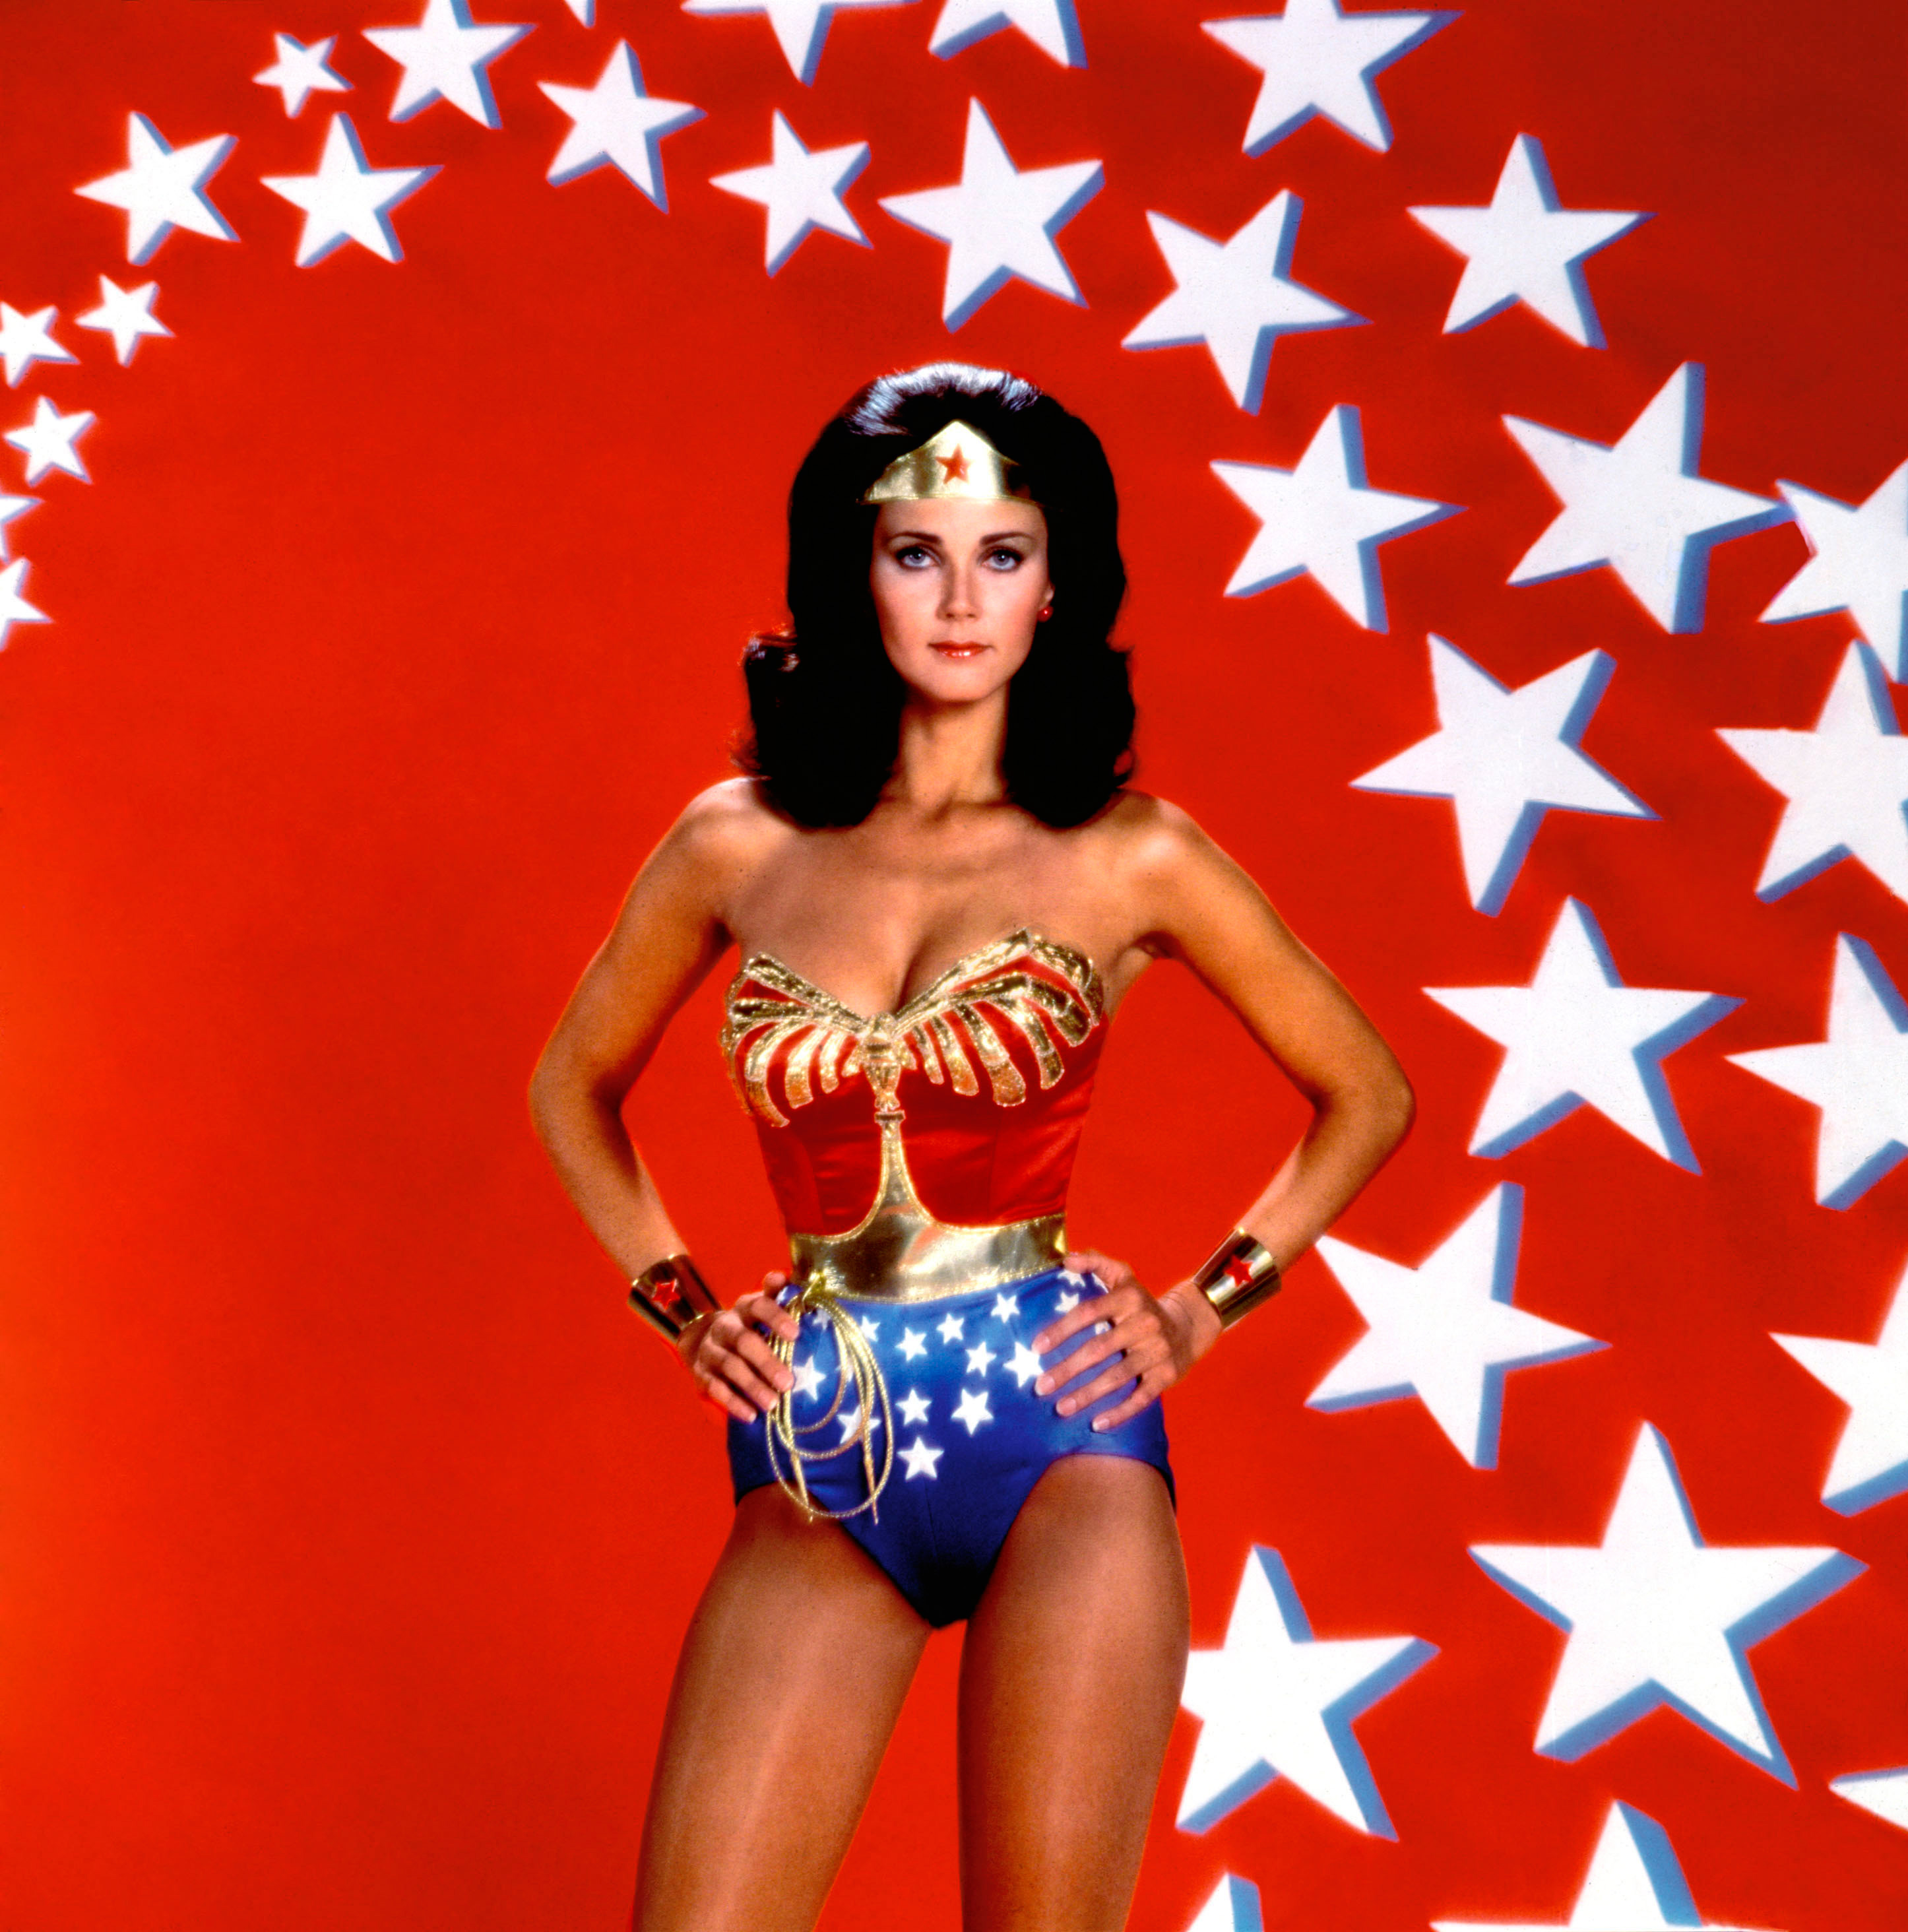
Lynda Carter

Slide 5
Evening Contemplation
Is there anything unwonderful or unwonderous about Wonder Woman?
What do we need from the myth of Wonder Woman, even if is in the form of the comic book?

Slide 6
Golden Age of Wonder Woman
First appeared in All Star Comics #8
First cover appearance in 1941, Sensation Comics #1
Created by psychologist William Moulton Marston
He was interested in the concept of detecting deception
Marston invented the polygraph “lie detector” and wrote comics under the pen name “Charles Moulton”
Moulton wanted to create a new type who should, as he believed “rule the world”
Artist Harry G. Peter
First comic book superheroine
Superpowered amazonian princesss—strength equal to Superman
Born into the conservative world of1940’s America: an era of homemakers and housewives

Slide 7
No Ordinary Comic-book Superhero
Much more than just a female version of Superman
At the center of the histories of science, law, and politics
At the center of comic book superheroes
Explores issues of gender stereotypes
She herself was gender atypical—transgressed gender norms
A response to what Marston saw as a “Social problem”
Feminist fictional utopia
WW was a unique creation: she represented a blend of American patriotism, fantasy, ancient myth, science fiction

Slide 8
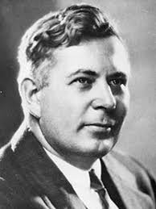
The Stereotypical Writer?
Psychologist
Polymath
Expert in deception
Invented the lie detector test
He led a secret life
Four children by 2 women
They all lived together

Slide 9
Stereotypical Woman?
William Moulton Marston:
Not even girls want to be girls so long as our feminine archetype lacks force, strength, and power. Not wanting to be girls, they don’t want to be tender, submissive, peace-loving as good women are. Women’s strong qualities have become despised because of their weakness. The obvious remedy is to create a feminine character with all the strength of Superman plus all the allure of a good and beautiful woman. (The American Scholar)

Slide 10
Feminism
Its concern: to unsettle & challenge gender inequalities, the values and norms of patriarchy
Female: a biological matter
Feminine: a set of culturally defined characteristics
Feminist: A political position

Slide 11
Feminist Theory
Exposes and challenges the values of patriarchy ( a system or society ruled and governed by men)
Exposes gender inequalities and gender roles
Womanhood and gender roles become social and cultural “constructs” or “mindsets”
Differences are created and defined in a particular social, cultural, historical moment

Slide 12
Gender studies
Identity/gender as role-play and performance
Gender is a social construct
Judith Butler, Gender Trouble (1990); Bodies That Matter (1993)
Gender is naturalized, fixed, stable—in its daily repetition
Differences in men and women (qualities that make them masculine and feminine) are learned
They are not innate or natural
There is no denial of biological differences (according to social constructionists)
biological differences are the not the cause of social and psychological differences

Slide 13
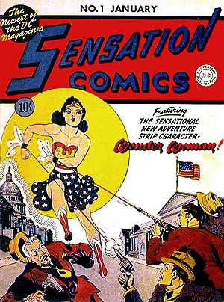
Sensation Comics #1, 1941

Slide 14
Golden Age of Wonder Woman
Archetype of female empowerment
Secret identity: Diana Prince (echoes Clark Kent)
Diana’s World: Steve Trevor, Etta Candy, the Robot Plane, the magic lasso, bullets and bracelets
Magic lasso-forced the captive to tell the truth
Key Themes of this period:
The rights of women
gender equality
Fighting sexism
ideas of women’s superiority
Domination and submission

Slide 15
What is so Wondrous about Wonder Woman?
Exceptional power…for a woman
She is the recognition of exceptional achievement for women
Athleticism
Physical Strength—not just strong but highly skilled in many ways: she studies combat, arts, sciences
Love: Wonder Woman comics were intended to counter the gorier, male-oriented comics; to temper masculine violence with love-a “feminine quality”
Compassion
Justice
Female power
Highly intelligent
Warrior woman—skilled in warfare; martial power
Frederic Wertham: called Wonder Woman a lesbian and hence a “frightening image” for boys, a “morbid ideal” for girls

Slide 16
Conventions of Wonder Women stories (earlier ones)
Society’s problems are wrought by men
Society’s problems would be solved by women
These women, unlike men, would rule the world with love, compassion, and justice.
Peace and justice can only be attained through the leadership and advancement of women
Narrative arc: problem in society that is usually male-wrought, concerns saving Steve Trevor with the Help of her female community led by Etta Candy. Order is reestablished in society. The women save the day but the recognition goes to Steve Trevor.

Slide 17
Female archetypes of the Western Imagination
The Amazon
The Great Mother
Blessed Virgin Mary

Slide 18
The Amazons: The New Women?
Ancient Myth of the Amazon:
The name Amazon derives from the Greek words “without a breast”
Referred to the removal of the right breast for solving the problem of how a normally constructed woman could operate the heavy bow used in ancient warfare
Amazons in Wonder Woman: a race of immortal women who lived in self-imposed exile from “Man’s World”
A band of women; a sisterhood of undefeated warriors
matriarchal society; a comraderie of women
Queen Hippolyta—won in a battle with Hercules; who took his revenge with conquest--raped her and enslaved the Amazons

Slide 19
Amazons
Aphrodite demanded that the women never remove the metal bracelets Hercules and his men had placed on them, as a reminder of their days in subjugation
Back story of conquest by the forces of patriarchal civilization
Wonder Woman is the amazonian icon but with an important difference: she is in love with a mortal man

Slide 20
Settings
1. World of Greek Mythology
2. Paradise Island: tropical Eden
Hidden; unknown;
3. Land of Amazonia
Magic sphere: gateway to the outside world
A man-free space: feminist utopia; fantasy fiction
During Moulton’s time (until his death in 1947), the interaction between Diana and the Amazons was limited
Presence of Amazon characters was limited
4. Various Modern cities
Gods interfering in modern day; impact on humanity

Slide 21
Wonder Woman: Origin Story (1941) Version
All Star Comics: “Introducing Wonder Woman”
Disturbance on Paradise Island; a man enters the Island
We meet Diana; her capacity to heal is first thing we learn about her
She carried the man “as if he were a child”—image of the nurturing mother; infantilization of the man (5)
This comic gives us the back story to the Amazons
A “race of Wonder Women” (7)

Slide 22
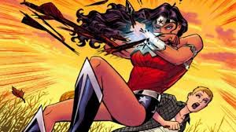
DC’s New 52 Series
Started in 2011
Focusing on the golden age heroes,
DC’s reboots of the comic book tradition
52 new books and titles were phased in
DC could maintain and revitalize their market presence

Slide 23
Wonder Woman. Vol 1: Blood: Game of intrigue & power
There is a battle for Zeus’ throne b/c it is empty; the political future of Olympus is on the line
revive the paradigms of greek myth and its gods and to reconnect the human spirit with the golden age
Wonder woman given a new origin story
Women, creation, birth stories—Theogony
Male gods threatened by progeny

Slide 24
New 52; New Woman
Still strong
Original featured a celebration of women’s history
This one features a celebration of women and
myth
She is no longer a pre-packaged hero
Book about relationships between women
Dark look at Diana’s relationship with the Amazons

Slide 25
Mythical Model
Theogony
It presents the creation of the gods and the universe and the consolidation of the gods' power as two things:
a struggle between fathers and sons
a struggle between male force and female birth.
Bias in Theogony is evident: he celebrates Zeus and the power of the male gods over the female goddesses; why is this so?

Slide 26
Question: How is the paradigm overturned, or in other words, is Hesiod’s bias mimicked or overturned in Azzarello’s Wonder Woman?

Slide 27
Mother as creator—the goddess Maia
The mysteries of creation are embodies in myths of the goddess; usually embodied three forms the make her into a universal archetype:
Mother
Virgin
Crone (old woman)
She is the universal archetype for the creation, preservation, and dissolution of the world

Slide 28
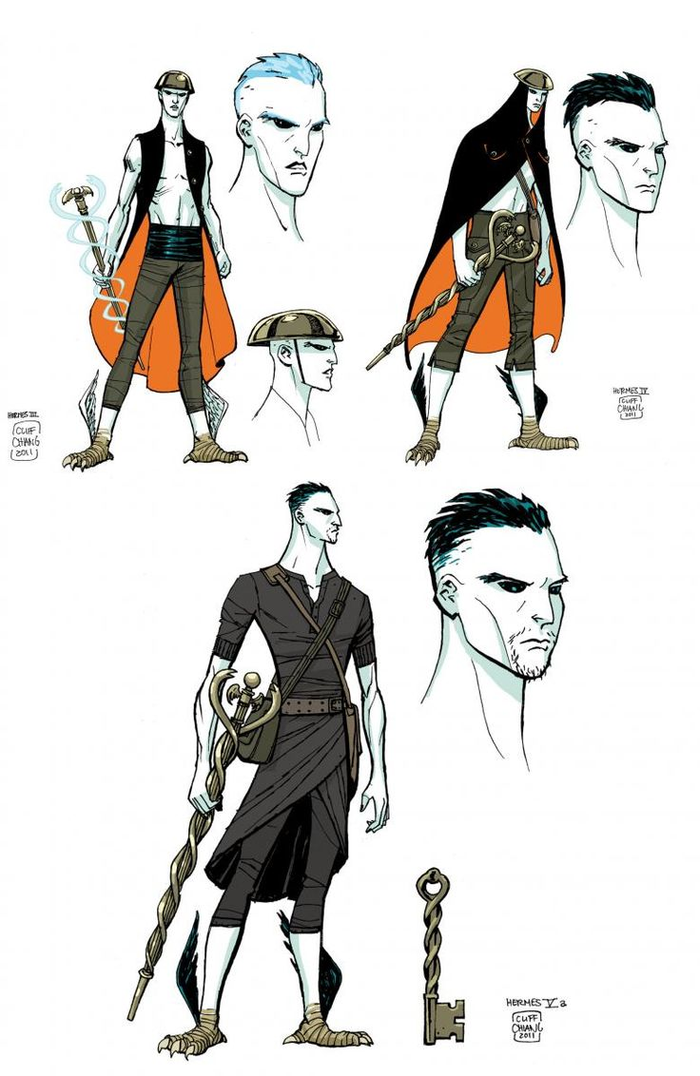
Hermes
Hermes is the mimetic expression of a return to unity or Gaia
His duty is to serve as a mediator between the divine and moral realms
Weapon: caduceus
messenger

Slide 29
The creation of women
Pandora
Two versions in Hesiod
Bringer of evils to mankind
Punishment to mankind form Zeus
Mother of Bronze Age
She marks the end of the silver age
Wonder Woman: where does she fit in all this?

Slide 30
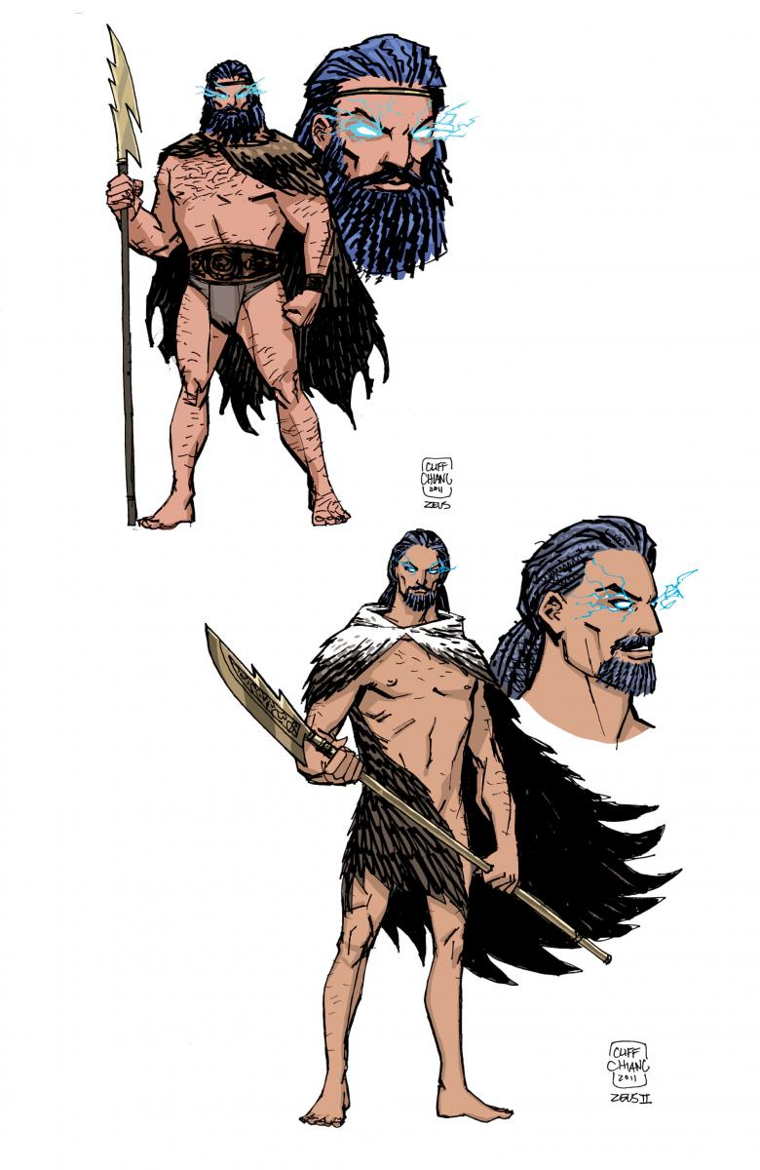
Zeus
Zeus is the prototype of the Sky God
Cloud Gatherer; storm bringer
Symbol is the thunder bolt
His myth is twofold:
1. Prototypical sky god (he generates manifestations of the One)
2. Archetypal hero

Slide 31
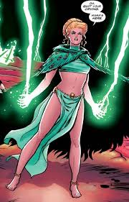
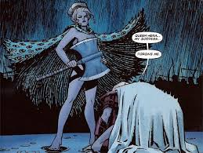
Hera

Slide 32
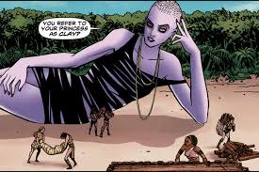
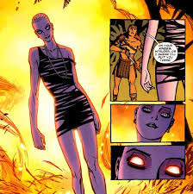
Strife

Slide 33
Strife
2 kinds of Strife in W&D
good & bad
Hesiod offers a series of oppositions
This opposition shows that you cannot get wealthy without honest work
But Strife is Hesiod’s way of introducing the essential opposition of good and evil

Slide 34
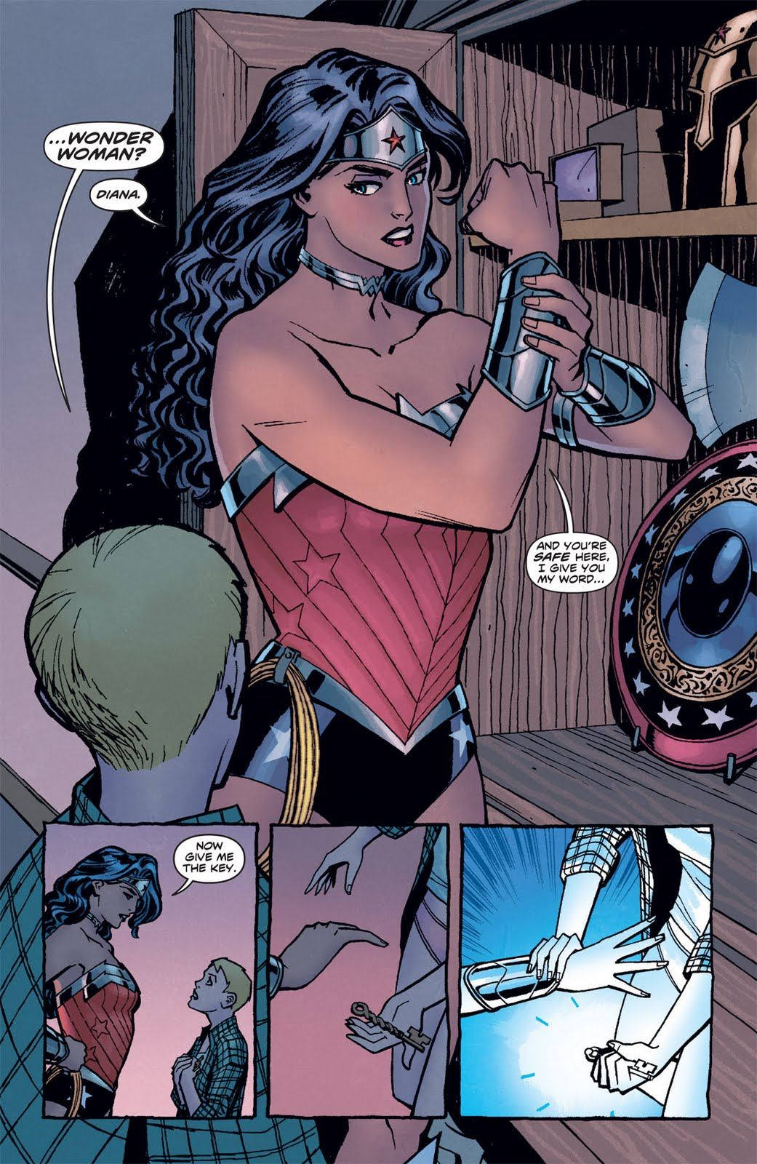
Diana
She prefers to be called Diana
We first meet her in the moonlight
The perfect amazon—“ no male seed created her”

Slide 35
Wonder woman –gender stereotypes-Linda Stein
http://www.youtube.com/watch?v=6-xMFvGSPH4
Wonder Women! The Untold Story of American Superheroines
https://www.youtube.com/watch?v=qUvpkfON9Cg

